Slide 1
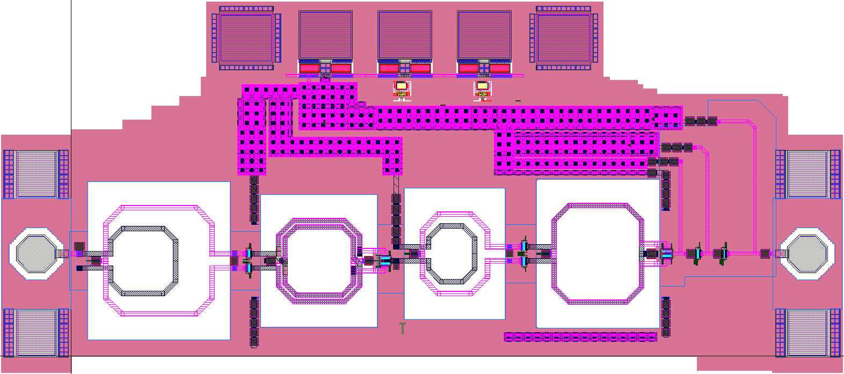
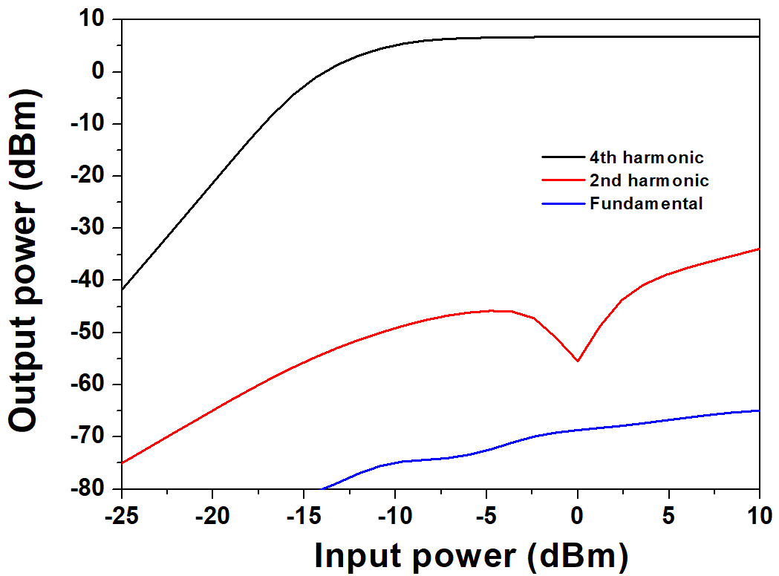
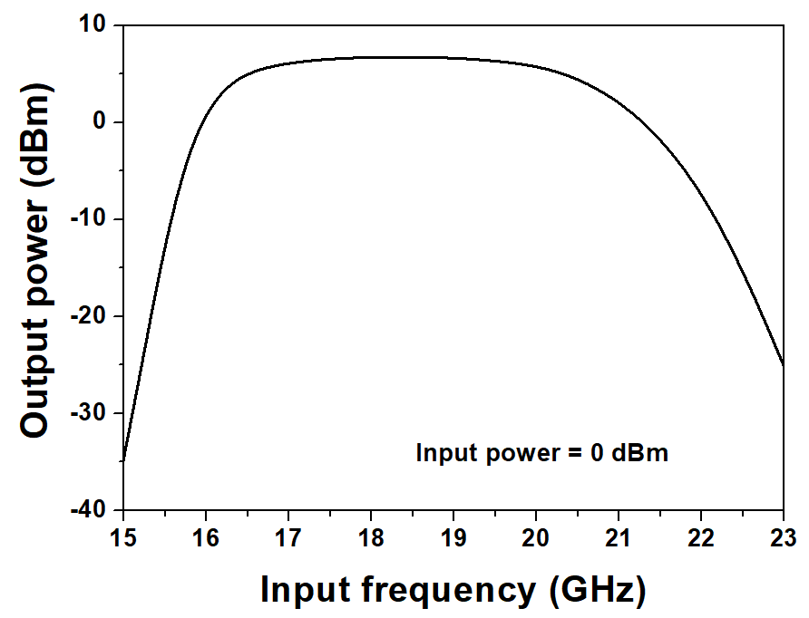
A Design of 17.5-to-70 GHz Frequency Quadrupler based on 65-nm CMOS Technology
Wooyong Keum, Junghawn Yoo, Jaeman Lee and Jae-Sung Rieh
High Speed Integrated System Lab.
Korea University, Anam-ro 145 Seongbuk-gu, Seoul, Korea
Abstract
In this work, a 17.5-to-70 GHz frequency quadrupler has been designed based on a 65-nm CMOS technology. The designed quadrupler consists of two push-push doublers, which includes a drive amplifier in each stage. The frequency quadrupler exhibits 6.8-dBm saturated output power, 5-dB conversion gain and 3-dB bandwidth is from 16.3 GHz to 20.7 GHz, with 0-dBm input power. Total DC power consumption is 71.2 mW and circuit size including the pads is 1060 × 467 μm².
1. Introduction
A stable LO(local oscillator) signal is essential For operating RF front-end of wireless communication system and radar which operates above 100 GHz. In general, there are two method for supplying LO signal; Design of oscillator for target operating frequency and multiplication of a stable signal which is lower than target frequency by implementation of frequency multiplier.
Second method can improve the phase noise and bandwidth of LO signal at cost of limited DC power and area. In this work, a 17.5-to-70 GHz frequency doubler is designed based on 65-nm CMOS technology for radar system.
2. Circuit Design
Two push-push doubler is employed to implement the frequency quadrupler.
Each push-push doubler consists of driver amplifier and second harmonic extraction part.
For wideband application, the matching network are designed by using dual resonant transformer which is composed of two inductors of different radius and shunt capacitors. [1]
3. Simulation Result
Saturated output power, P_{sat} = 6.8 dBm @ 74 GHz
Conversion gain = 5 dB
3-dB bandwidth = 16.3 – 20.7 GHz (with 0-dBm P_{in})
Harmonic rejection = more than 40 dB
DC power consumption = 71.2 mW
1060 μm
467 μm
Fig 2. Layout of frequency quadrupler, 1060 × 467 μm²
(a)
(b)
Fig 3. Simulation result
(a) P_{in} vs. P_{out} (b) f_{in} vs. Pout with P_{in} = 0 dBm
Fig 1. Schematic of frequency quadrupler
Conclusion
A 17.5-to-70 GHz frequency multiplier which employs the dual resonant transformer has been designed in this work based on 65-nm CMOS technology. The frequency multiplier exhibits 6.8-dBm saturated output power, 5-dB conversion gain and 3-dB bandwidth is from 16.3 GHz to 20.7 GHz, with 0-dBm input power. Total DC power consumption is 71.2 mW. The designed frequency multiplier can be applied to W- or D- band LO signal generator for wireless communication or radar system.
Acknowledgement
The chip fabrication and EDA tool were supported by the IC Design Education Center(IDEC), Korea.
Reference
[1] Z. Chen, Y. Yu, Y. Wu, H. Liu, C. Zhao and K. Kang, "A 19.5% Efficiency 51–73-GHz High-Output Power Frequency Doubler in 65-nm CMOS," in IEEE Microwave and Wireless Components Letters, vol. 29, no. 12, pp. 818-821, Dec. 2019.

